Slide 1



X
Digital User Churn Dashboard PT. Sejahtera Bersama
Bank Muamalat Business Intelligence Analyst Project-Based Intership Program
Presented by
Muhammad Fadhilah Faqih R

Slide 2

Table of Contents
1. Case Study
4. Primary Keys
7. Key Metric
2. Tools
5. ERD
8. Dashboard
3. Dataset
6. Table Master
9. Insight & Recommendation

Slide 3



Muhammad Fadhilah Faqih R
Experience
RevoU Mini Course: Data Analytics
Microsoft Excel, SQL, Python, Data Vizualization
About You
Data Analysis MySkill Fullstack Intensive Bootcamp Batch 18
Statistics, Problem Solving, Data Formatting & Validation, Data Cleansing, SQL ,Python, Data Visualization
Graduate of Informatics Engineering with a strong interest in data and analytics. During my studies, I developed skills in programming, databases, and information technology. However, as the digital world continues to evolve, I discovered a new passion for the field of data analysis.
Menguasai Fundamental Business Analyst by Kelas.com
Fundamental Business Analyst, BRD, Model Business & Process, Analitics. Communication & Presentation, Data Analysis & Decision Making, Project Management, Etika & Proffesionalisme

Slide 4
Case Study
PT Sejahtera Bersama aims to analyze sales data to identify transaction patterns and enhance business performance. By integrating data from four different tables, a master table is created to consolidate key information.
This data is then visualized in Looker Studio to monitor total sales, order quantities, and top-performing cities. Based on the analysis, several strategic business recommendations are proposed. With this data-driven approach, PT Sejahtera Bersama can effectively sustain and accelerate sales growth.

Slide 5


Tools

Slide 6
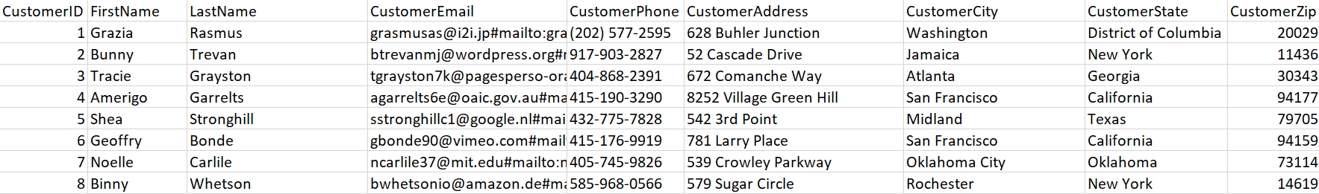
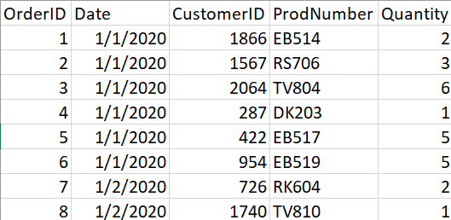
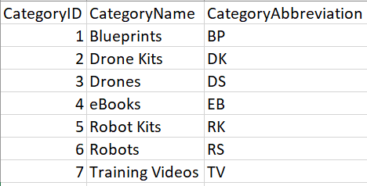
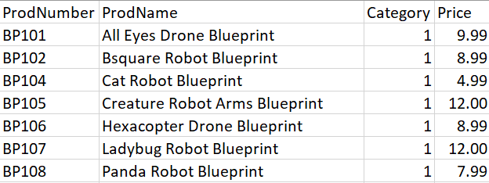
Dataset
Tabel Customer
Tabel Orders
Tabel ProductCategory
Tabel Products

Slide 7
Primary Keys
To Create a table master for analysis, we first need to define primary keys for each dataset. A Primary keys is a unique indentifier for each record in table, ensuring data integrity and enabling relationships between tables. The primary keys for each dataset are:
Customers → CustomerID
Products → ProdNumber
Orders → OrderID
ProductCategory → CategoryID
These primary keys allow us to establish relationships between tables, making it possible to join and analyze data effectively.

Slide 8
Entity Relationship Diagram (ERD)
The Relationships among these tables are structured as follows:
Customers → Orders (CustomerID) → One to Many (1:M)
Orders → Products (ProdNumber) → Many to Many (M:1)
Products→Product CategoryID (Category → CategoryID) → Many to One (M:1)
To Analyze sales data, we use SQL JOIN operations to merge these tables based on their relationships. A SQL Query can be written to join all four tables and extract the necessary fields for future insight.

Slide 9
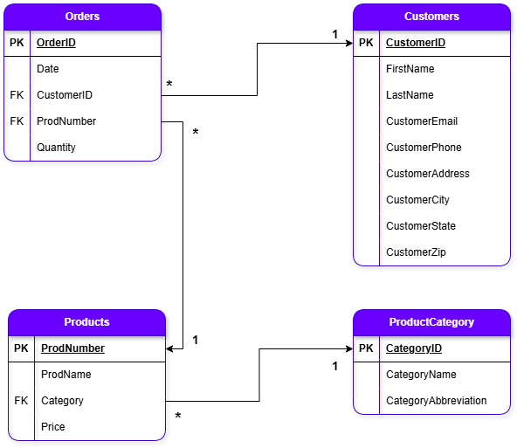
Entity Relationship Diagram (ERD)

Slide 10
Table Master
From these datasets, we will create a table master containing:
CustomerEmail (cust_email)
CustomerCity (cust_city)
OrderDate (order_date)
OrderQty (order_qty)
ProductName (product_name)
ProductPrice (product_price)
ProductCategory (product_category)
TotalSales (total_sales)
This table master will be sorted by order date ( from earliest to latest ) and saved in CSV format for further analysis.

Slide 11
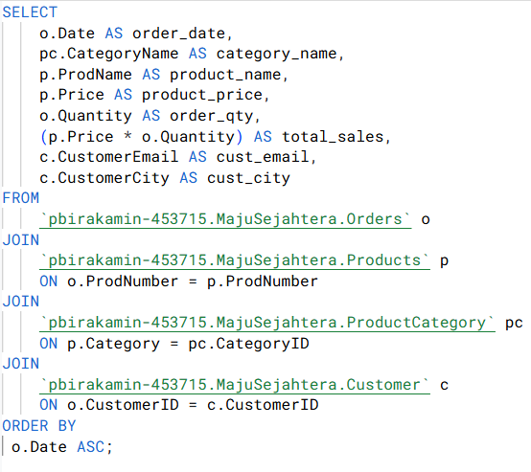
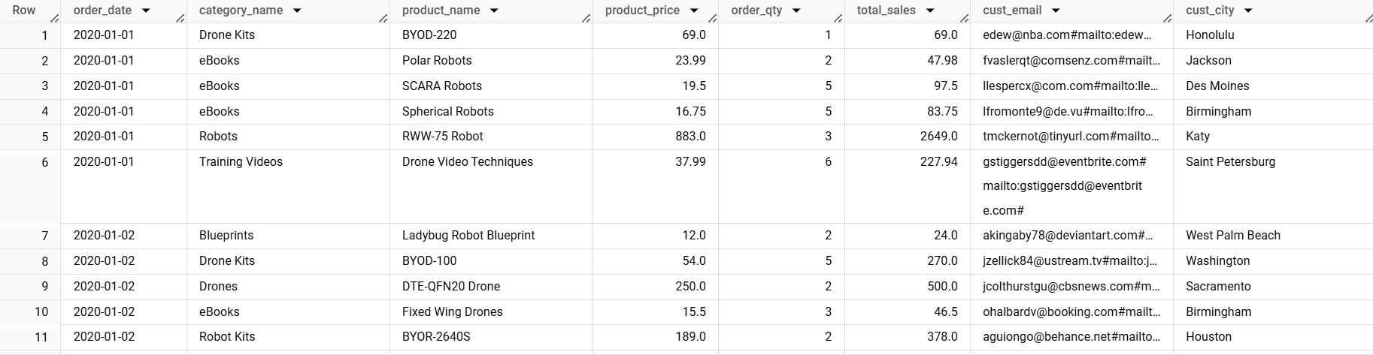
Table Master
Query
Query Result

Slide 12
Key Metrics
Using Looker Studio, Create a visualization to display the sales data. The dashboard should include at least the following key metrics:
Total Sales
Total Sales by Product Category
Total Quantity by Product Category
Total Sales by City
Total Quantity by City
Top 5 Product Categories by Sales
Top 5 Product Categories by Total Quantity
As a BI Analyst at PT Sejahtera Bersama, we can leverage the detailed transaction table to develop strategies for maintaining and increasing sales.

Slide 13
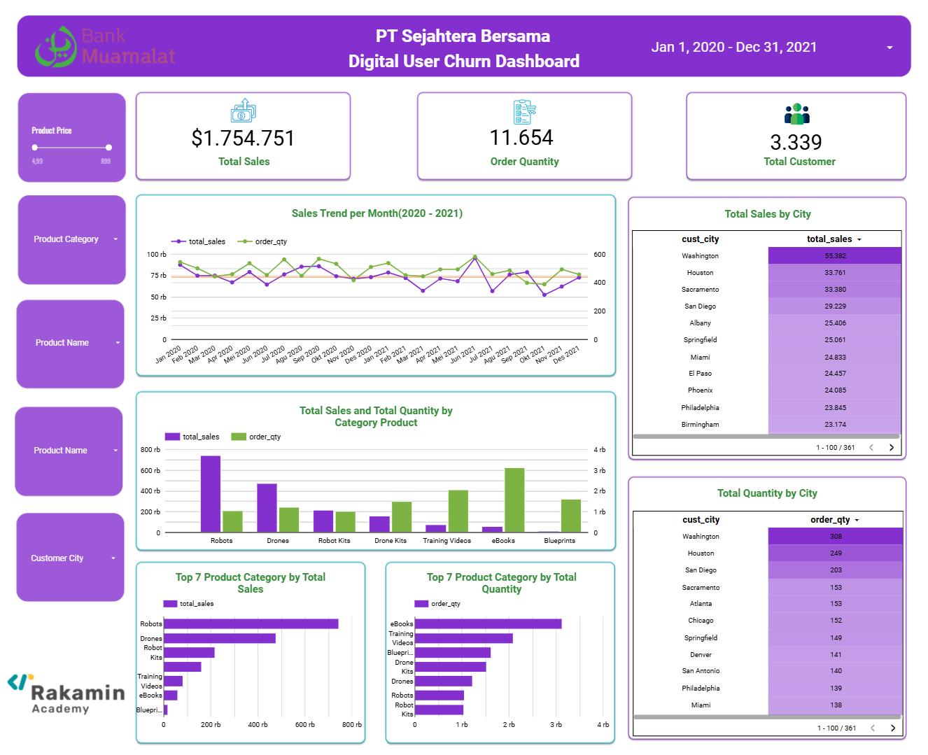
Visualisasi Dashboard
Link Looker Studio :
https://lookerstudio.google.com/reporting/1726aa9b-c22d-4d22-b1a4-beedff3b4524

Slide 14
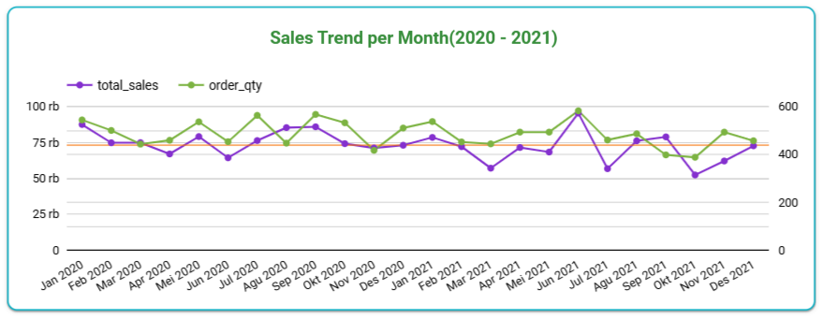

Insight
The trendlines indicate a gradual decline in both Total Sales and Order Quantity over time, accompanied by noticeable seasonal fluctuations throughout each year.
A significant peak was observed in June 2021, where Total Sales reached 95,401.53 and Order Quantity climbed to 582, most likely driven by major promotional campaigns or mid-year market demand.
However, following this peak, several months exhibited notable declines:
March 2021: Total Sales decreased to 57,080.91, down from 72,040.18 in February.
July 2021: Total Sales dropped sharply to 56,720.86, considerably lower compared to June.
October 2021: A further decline occurred, with Total Sales falling to 52,348.49 and Order Quantity reducing to 388.
Conversely, both December 2020 and December 2021 recorded positive sales growth, likely influenced by year-end shopping behavior and festive season demand.

Slide 15
Recommendations
Given the significant peak in June 2021, ensure that mid-year promotional campaigns are carefully planned and well-executed.
Following sales peaks (such as post-June), implement retention strategies through loyalty programs, targeted email marketing, and personalized offers to minimize sales decline.
Conduct root cause analysis for months with sharp declines (March, July, and October).
Investigate potential causes, including pricing strategy, stock availability, competitive activity, or changes in customer behavior.
Initiate holiday campaigns starting from November to extend purchasing momentum.

Slide 16
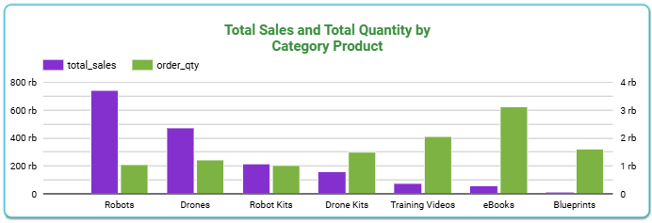
Insight
Robots — Achieved the highest total sales of 743,505 despite having a relatively low order quantity of 1,053. This indicates that robots are premium products, primarily targeted toward corporate clients or tech-savvy individuals who are willing to invest in high-value purchases.
Robot Kits — Recorded the lowest total sales and order quantity. This suggests that the product may be less attractive to customers, possibly due to minimal marketing efforts or pricing that does not align with customer expectations. A pricing and promotion review is recommended.
eBooks — Dominated in order quantity with 3,123 units sold but generated lower total sales of 58,968.41. This highlights their affordability and ease of distribution, making them highly accessible and often purchased in bulk for educational or complementary purposes.
Blueprints — Showed the lowest total sales value of 16,434.51. These products are typically purchased as add-ons to primary products, with pricing that reflects their supplementary nature.
Consumer Behavior Trends The data shows that eBooks and Blueprints are more popular among consumers due to their affordability, ease of access, and their function as complementary products. In contrast, Robots are positioned as high-value items for niche markets, while Robot Kits require strategic attention to improve their market appeal.

Slide 17
Recommendations
1. Robots (Premium Product)
Strengthen targeted marketing campaigns aimed at corporate clients and tech professionals.
Enhance the premium brand positioning through business case studies, testimonials, and presence at tech events.
2. Robot Kits (Lowest Sales Performance)
Conduct a pricing review to ensure product value aligns with customer expectations.
Increase digital promotion efforts through social media advertising and influencer collaborations to boost brand awareness.
3. eBooks (Highest Order Volume)
Maintain affordability and accessibility as key strengths.
4. Blueprints (Supplementary Product)
Continue positioning blueprints as affordable add-on products.
Enhance product content and visuals to clearly communicate the value of blueprints as complementary resources

Slide 18
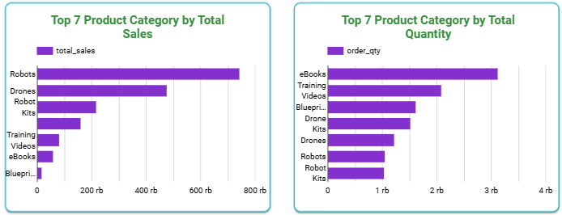
Insight
Premium Products (Robots & Drones) — High revenue contribution despite lower sales volume.
Digital Products (eBooks & Training Videos) — Strong sales due to affordability and accessibility.
Drones — High-value product with strong, consistent demand.
Drone Kits — Often purchased as accessories, showing bundling potential.
Training Videos — High demand from beginners, indicating the need for educational support.

Slide 19
Recommendations
1. Strengthen Premium Product Promotions
Focus marketing efforts on Robots and Drones to maximize revenue from premium categories.
Offer installment plans or exclusive programs to encourage purchases of high-ticket items.
2. Expand the Digital Product Portfolio
Add more eBooks and Training Videos on relevant topics to attract a wider customer base.
Create digital product bundles to increase transaction value
3. Develop Bundling Strategies
Offer Drone + Drone Kit bundles to boost accessory sales.
Provide special discounts for package purchases.
4. Enhance Educational Support for New Customers
Provide webinars, tutorials, and free educational content to attract and retain beginner-level buyers.
Create loyalty programs based on educational engagement (e.g., reward points for purchasing training videos).

Slide 20
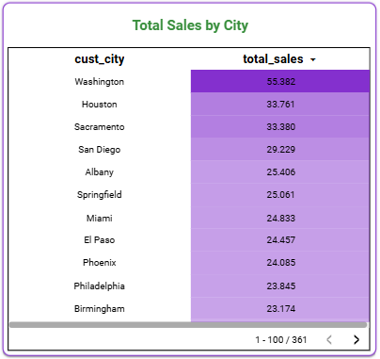
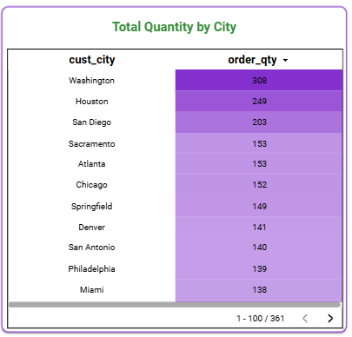
Insight
Washington leads in both total sales (55,382) and order quantity (308), indicating it is the strongest and most potential market.
Houston ranks second in total sales (33,761) and order quantity (249), showing consistent and stable demand.
Sacramento has relatively high total sales (33,380) but does not appear in the top three for order quantity, suggesting higher average transaction values per order.
San Diego ranks third in order quantity but is not in the top three for total sales, indicating an opportunity to increase transaction value in this city.

Slide 21
Recommendations
1. Focus on Washington
Strengthen marketing campaigns and loyalty programs to maintain leadership in both sales and order quantity.
Introduce exclusive offers to retain and grow high-value customers.
2. Optimize Sales in Houston
Continue targeted promotions to maintain steady demand.
Explore upselling and bundling strategies to increase average order value.
3. Leverage Sacramento’s High Transaction Value
Focus on premium product promotions and VIP customer programs.
Highlight high-end product features to encourage repeat purchases.
4. Increase Value in San Diego
Run campaigns focused on value bundles or product upgrades.
Educate customers on premium products to drive higher-value purchases.

Slide 22
Video Presentation Here
Please insert your link video here (You can upload the video on YouTube or Google Drive first)!

Slide 23
Thank You
X

